Slide 1
CISC 235: Topic 5
Dictionaries and Hash Tables

Slide 2
Outline
Dictionaries
  Dictionaries as Partial Functions
Unordered Dictionaries
  Implemented as Hash Tables
Collision Resolution Schemes
  Separate Chaining
  Linear Probing
  Quadratic Probing
  Double Hashing
Design of Hash Functions

Slide 3
Caller ID Problem Scenario
Consider a large phone company that wants to provide Caller ID to its customers:
- Given a phone number, return the caller’s name
Key Element
phone number caller’s name
Assumption: Phone numbers are unique and are in the range 0..10⁷ - 1. However, not all those numbers are current phone numbers.

Slide 4
Caller ID Solutions
Let u = number of possible key values: 10⁷
Let k = number of phone/name pairs
Use a linked list
  Time Analysis (search, insert, delete):
  Space Analysis:
Use a balanced binary search tree
  Time Analysis (search, insert, delete):
  Space Analysis:

Slide 5
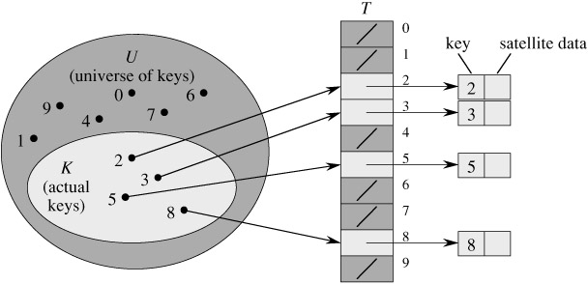
Direct-Address Table

Slide 6
Direct-address Tables
Direct-Address-Search( T, k )
return T[k]
Direct-Address-Insert( T, x )
T[ key[ x ] ] ⬅ x
Direct-Address-Delete( T, x )
T[ key[ x ] ] ⬅ NIL
We could use a direct-address table to implement caller-id, with the phone numbers as keys.
Time Analysis:
Space Analysis:

Slide 7
Dictionary as a Function
Given a key, return an element
Key Element
(domain: (range:
type of the keys) type of the elements)

Slide 8
Unordered Dictionary
Best Implementation: Hash Table
0
1
2
3
4
5
6
7
8
9
5336666 | “Sara Li”
Space: O(n)
Time: O(1) average-case
Key/Element Pairs
5336666
“Sara Li”
5661111
“Lea Ross”
Hash Function

Slide 9
Example Hash Function
h( k )
return k mod m
where k is the key and m is the size of the table

Slide 10
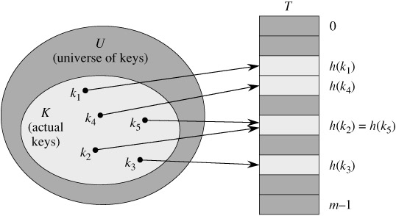
Hash Table with Collision

Slide 11
Collision Resolution Schemes: Chaining
The hash table is an array of linked lists
Insert Keys: 0, 1, 4, 9, 16, 25, 36, 49, 64, 81
Notes:
As before, elements would be associated with the keys
We’re using the hash function h(k) = k mod m
0
1
2
3
4
5
6
7
8
9
0
81
1
64
4
25
36
16
49
9

Slide 12
Chaining Algorithms
Chained-Hash-Insert( T, x )
insert x at the head of list T[ h( key[x] ) ]
Chained-Hash-Search( T, k )
search for an element with key k
in list T[ h(k) ]
Chained-Hash-Delete( T, x )
delete x from the list T[ h( key[x] ) ]

Slide 13
Collision Resolution Strategies:
Open Addressing
All elements stored in the hash table itself (the array). If a collision occurs, try alternate cells until empty cell is found.
Three Resolution Strategies:
Linear Probing
Quadratic Probing
Double Hashing
All these try cells h(k,0), h(k,1), h(k,2), …, h(k, m-1)
where h(k,i) = ( h′(k) + f(i) ) mod m, with f(0) = 0
The function f is the collision resolution strategy and the function h′ is the original (now auxiliary) hash function.

Slide 14
Linear Probing
Function f is linear. Typically, f(i) = i
So, h( k, i ) = ( h′(k) + i ) mod m
Offsets: 0, 1, 2, …, m-1
With H = h′( k ), we try the following cells with wraparound:
H, H + 1, H + 2, H + 3, …
0
1
2
3
4
5
6
7
8
9
What does the table look like after the following insertions?
Insert Keys: 0, 1, 4, 9, 16, 25, 36, 49, 64, 81

Slide 15
General Open Addressing Insertion Algorithm
Hash-Insert( T, k )
i ⬅ 0
repeat
j ⬅ h( k, i )
if T[ j ] = NIL
then T[ j ] ⬅ k
return j
else i ⬅ i + 1
until i = m
error “hash table overflow”

Slide 16
General Open Addressing Search Algorithm
Hash-Search( T, k )
i ⬅ 0
repeat
j ⬅ h( k, i )
if T[ j ] = k
then return j
i ⬅ i + 1
until T[ j ] = NIL or i = m
return NIL

Slide 17
Primary Clustering
Linear Probing is easy to implement, but it suffers from the problem of primary clustering:
Hashing several times in one area results in a cluster of occupied spaces in that area. Long runs of occupied spaces build up and the average search time increases.

Slide 18
Rehashing
Problem with both chaining & probing:
When the table gets too full, the average search time deteriorates from O(1) to O(n).
Solution: Create a larger table and then rehash all the elements into the new table
Time analysis:

Slide 19
Quadratic Probing
Function f is quadratic. Typically, f(i) = i²
So, h( k, i ) = ( h′(k) + i² ) mod m
Offsets: 0, 1, 4, …
With H = h′( k ), we try the following cells with wraparound:
H, H + 1², H + 2², H + 3² …
Insert Keys: 10, 23, 14, 9, 16, 25, 36, 44, 33
0
1
2
3
4
5
6
7
8
9

Slide 20
Double Hashing
If a collision occurs when inserting, apply a second auxiliary hash function, h₂(k), and probe at a distance h₂(k), 2 * h₂(k), 3 * h₂(k), etc. until find empty position.
So, f(i) = i * h₂(k) and we have two auxiliary functions:
h( k, i ) = ( h₁(k) + i * h₂(k) ) mod m
With H = h₁( k ), we try the following cells in sequence with wraparound:
H
H + h₂(k)
H + 2 * h₂(k)
H + 3 * h₂(k)
…
CISC 235 Topic 5

Slide 21
Double Hashing
In order for the entire table to be searched, the value of the second hash function, h₂(k), must be relatively prime to the table size m.
One of the best methods available for open addressing because the permutations produced have many of the characteristics of randomly chosen permutations
CISC 235 Topic 5

Slide 22
Choosing Hash Functions
A good hash function must be O(1) and must distribute keys evenly.
Division Method Hash Function for Integer Keys:
h(k) = k mod m

